Slide 1

Patrick, Johanna, Rose, Holly

Slide 2
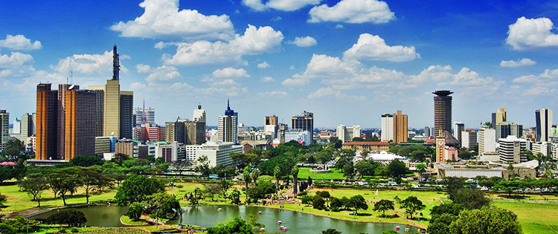




Summary
Analyze possible correlations in overall satisfaction ratings vs. price in four different cities across the world.
Amsterdam
Boston
San Francisco
Nairobi

Slide 3
Questions

Slide 4

Data

Slide 5
Data Cleanup & Exploration

Slide 6
Data Analysis

Slide 7
Questions

Slide 8
Questions

Slide 9
Questions

Slide 10
Questions

Slide 11
Questions

Slide 12
Questions

Slide 13
Questions

Slide 14
Difficulties and Opportunities

Slide 15
Questions?

